Slide 1
Customer Retention Case Study
Submitted by:
Preeti Singh

Slide 2
Process Involved In this Project
Library Initialization
Loading the dataset
Exploratory Data Analysis

Slide 3
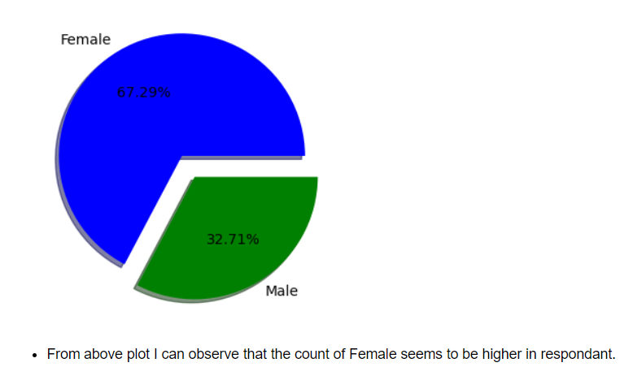
Exploratory Data Analysis
Gender of Respondent

Slide 4
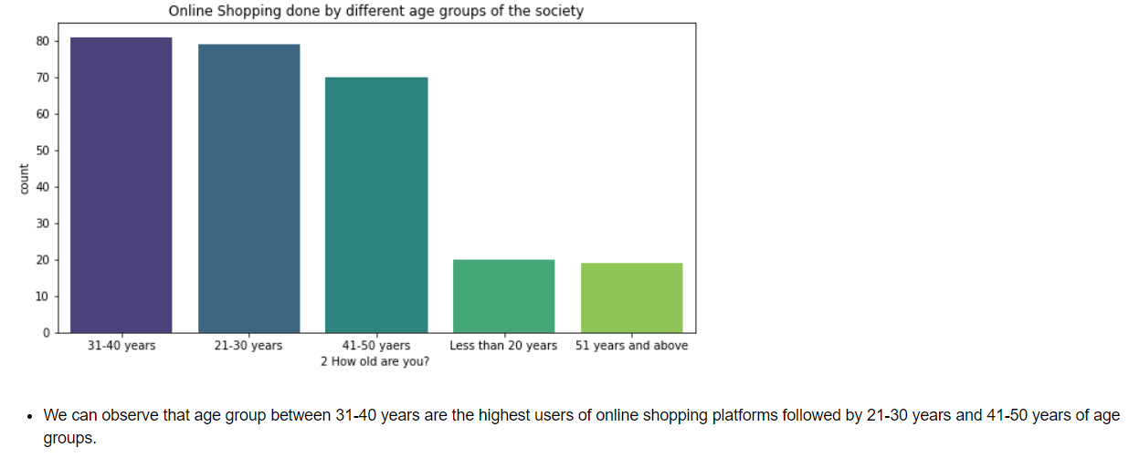

Slide 5
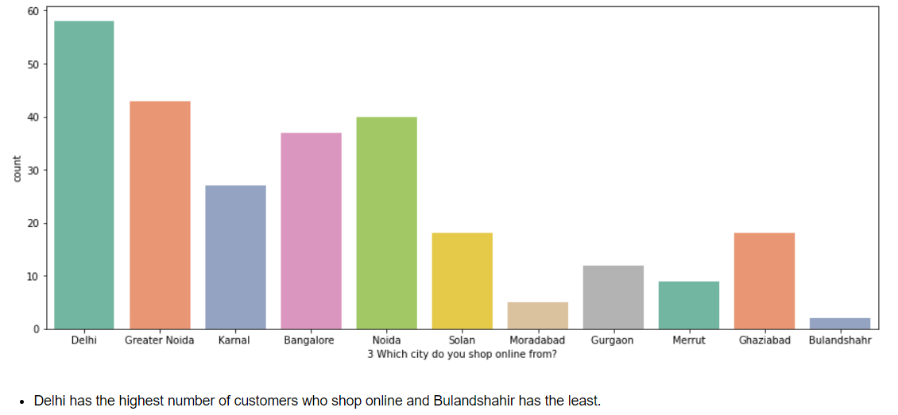

Slide 6
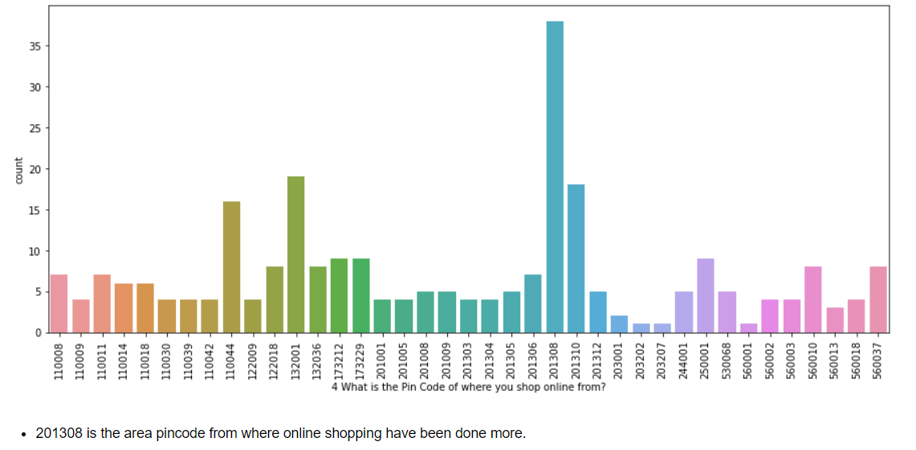

Slide 7
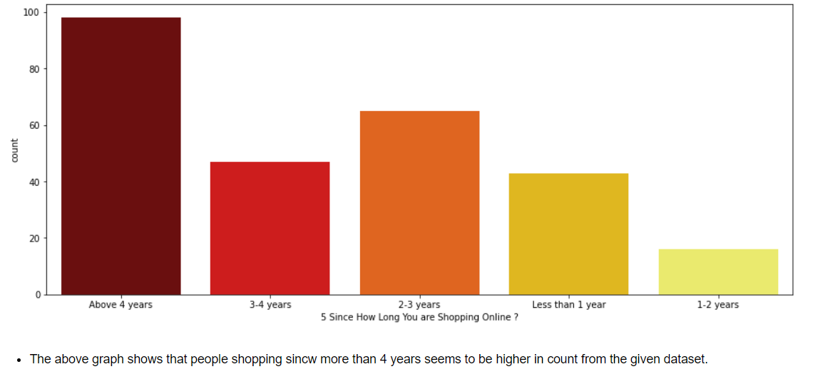

Slide 8
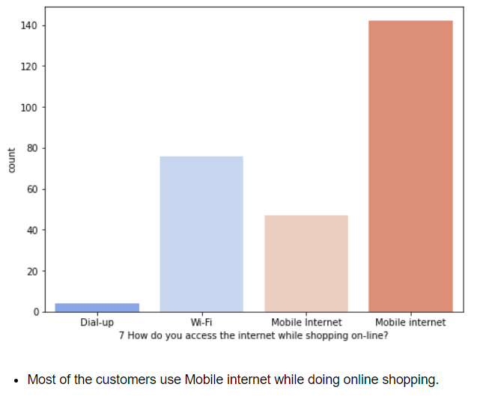

Slide 9
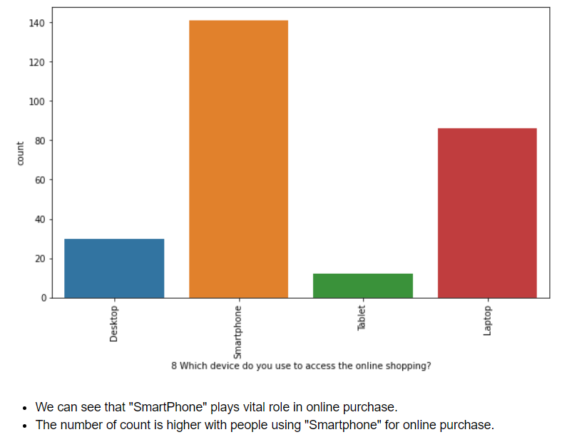

Slide 10
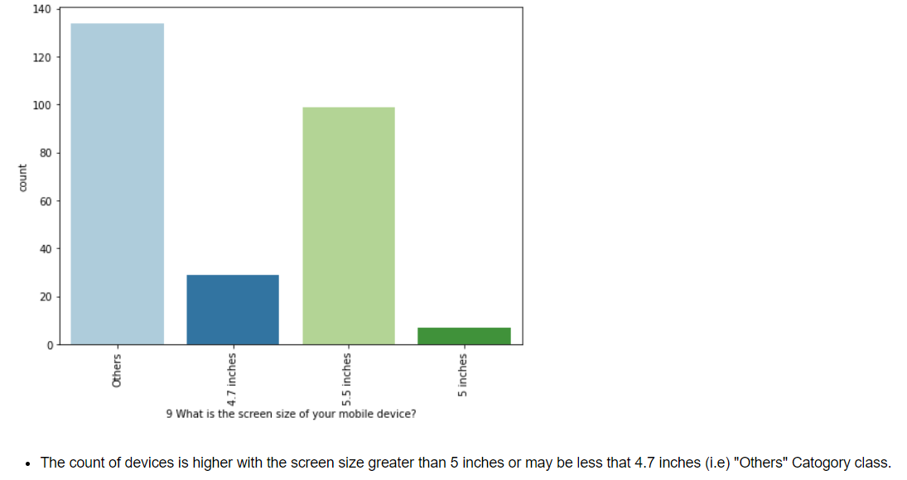

Slide 11
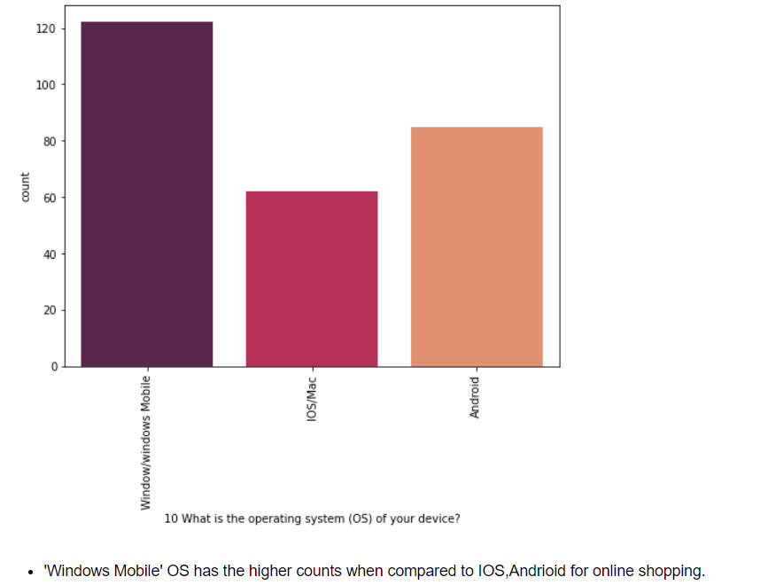

Slide 12
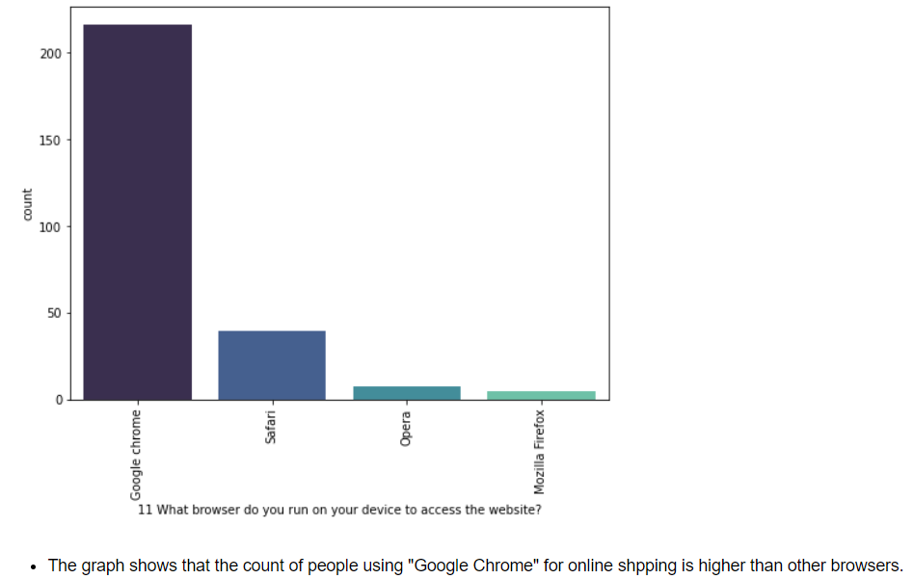

Slide 13
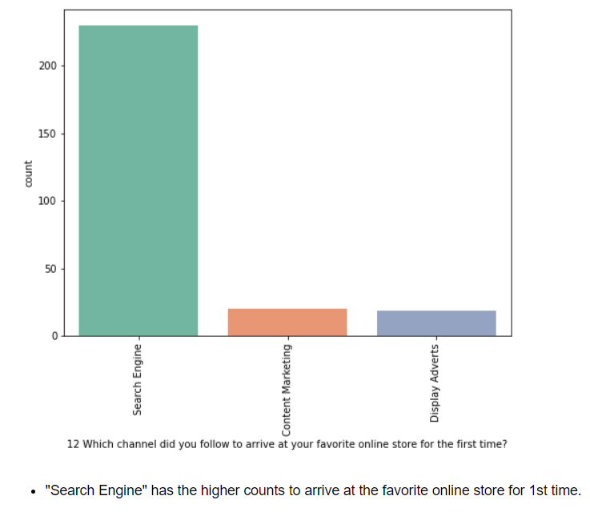

Slide 14
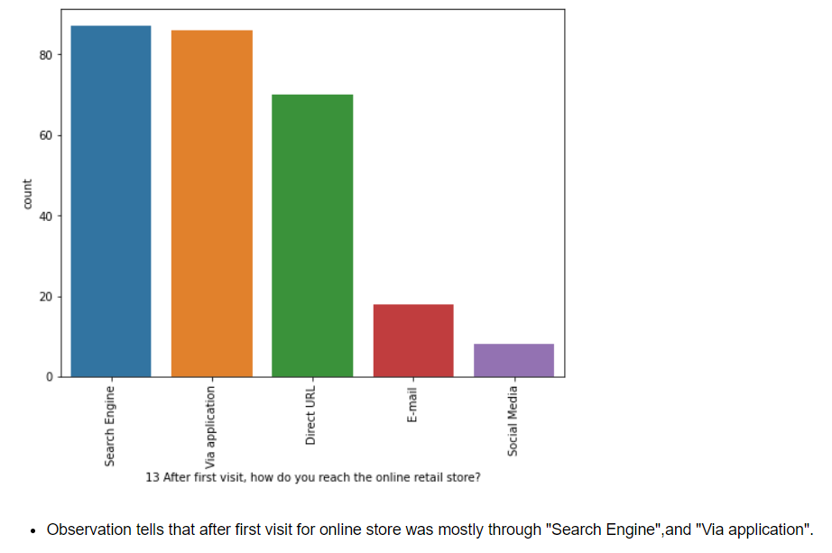

Slide 15
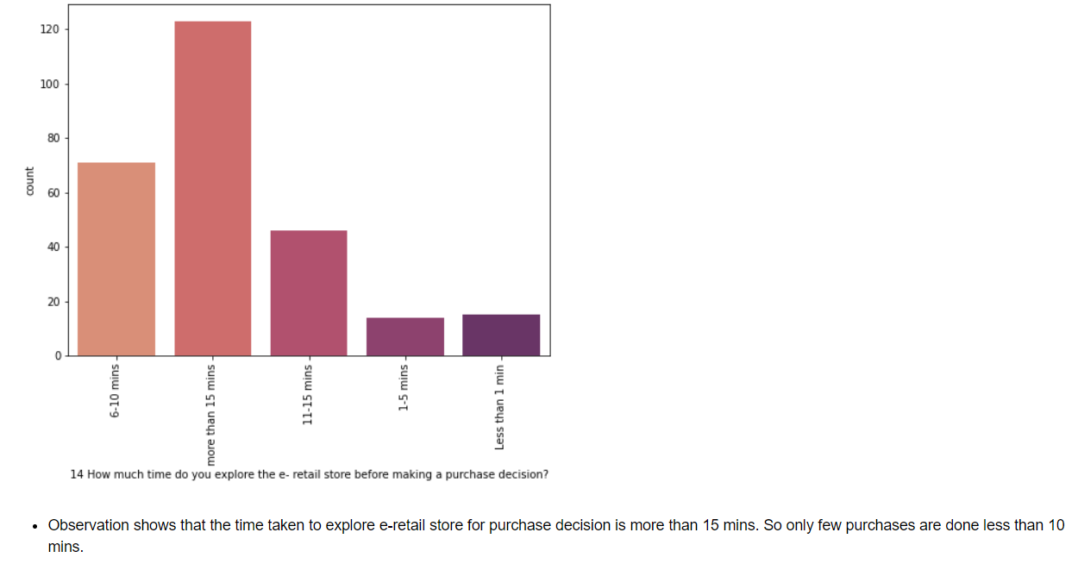

Slide 16
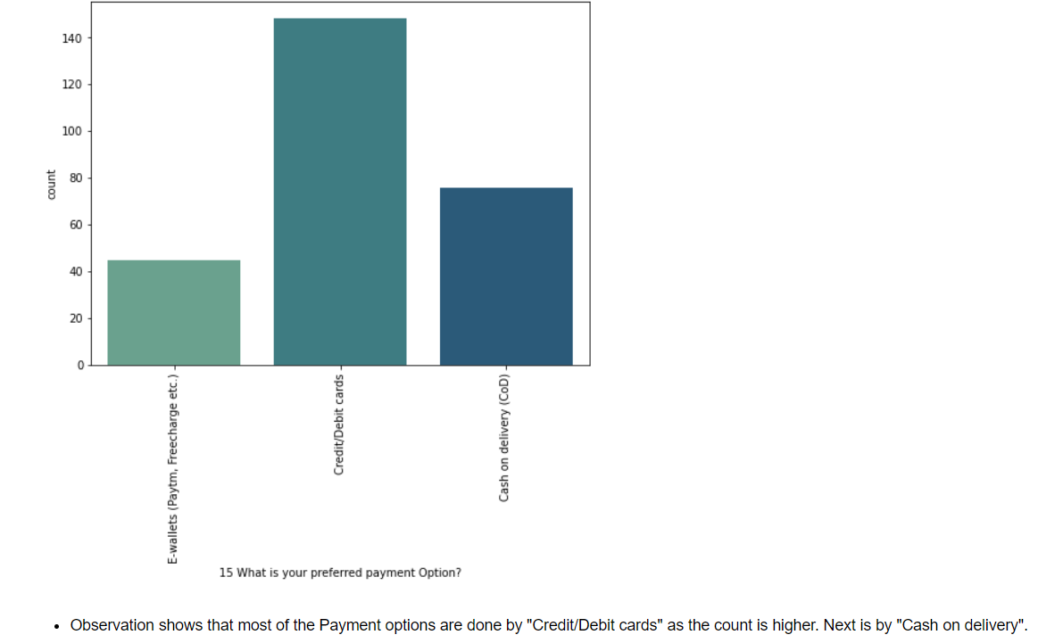

Slide 17
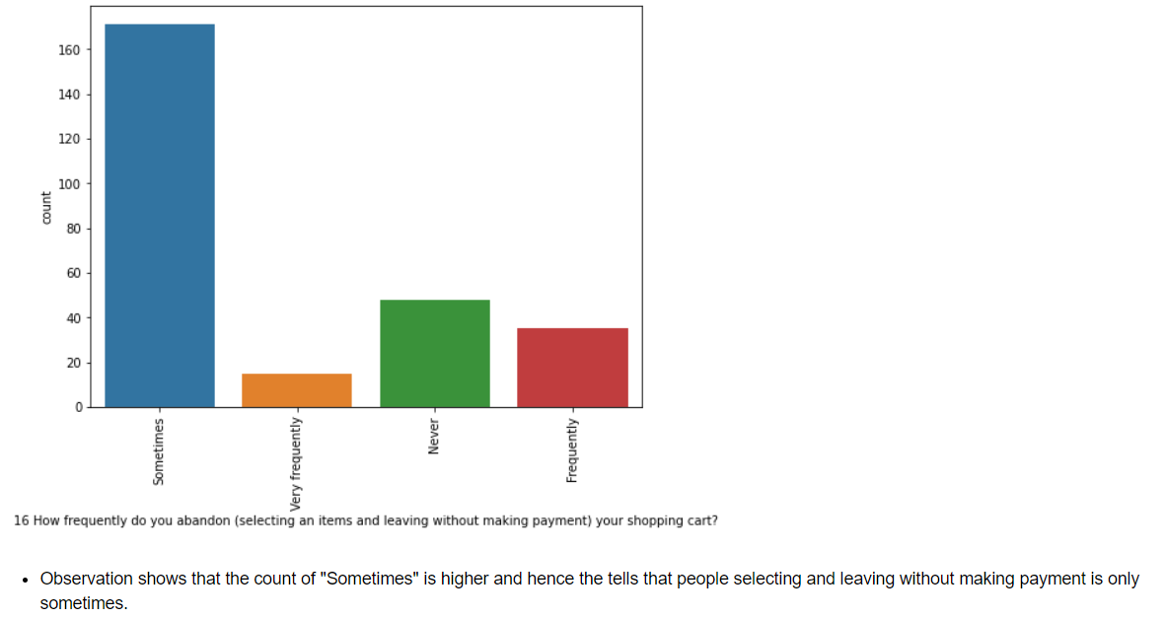

Slide 18
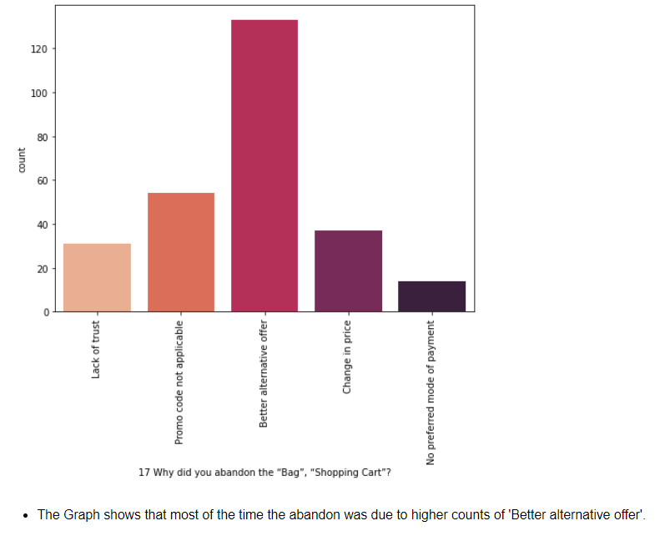

Slide 19
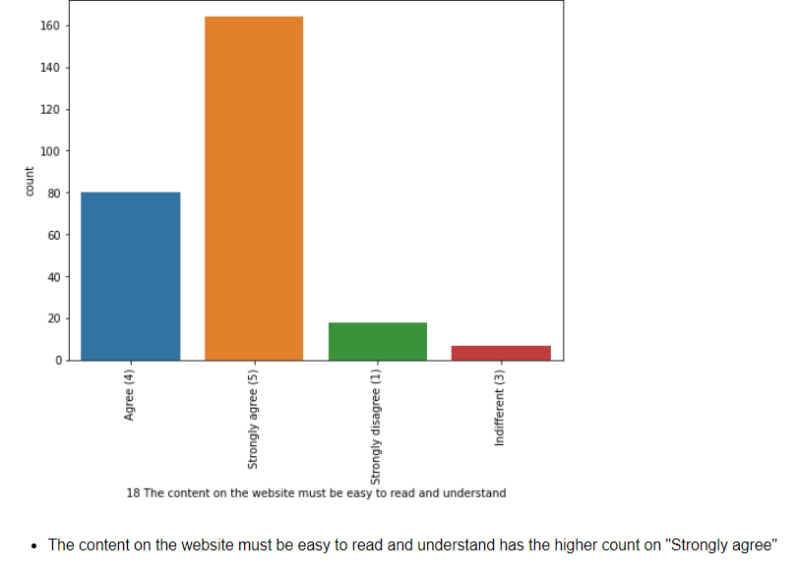

Slide 20
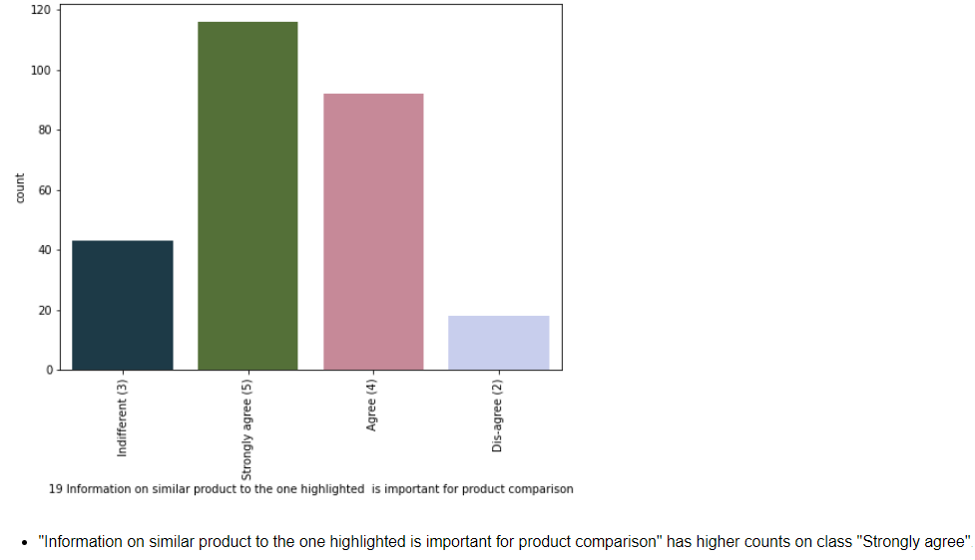

Slide 21
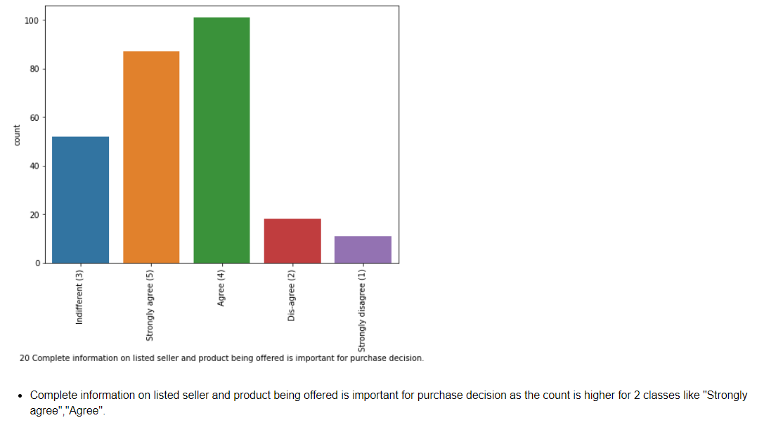

Slide 22
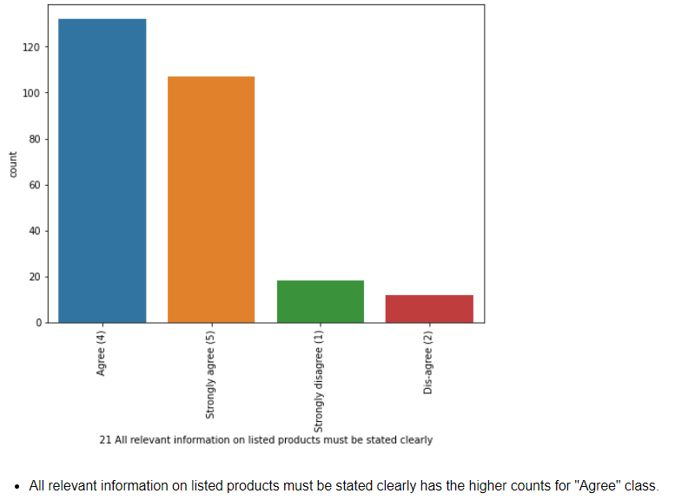

Slide 23
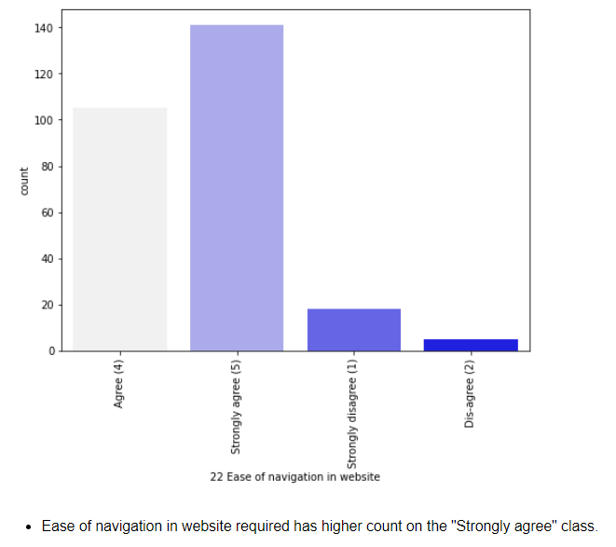

Slide 24
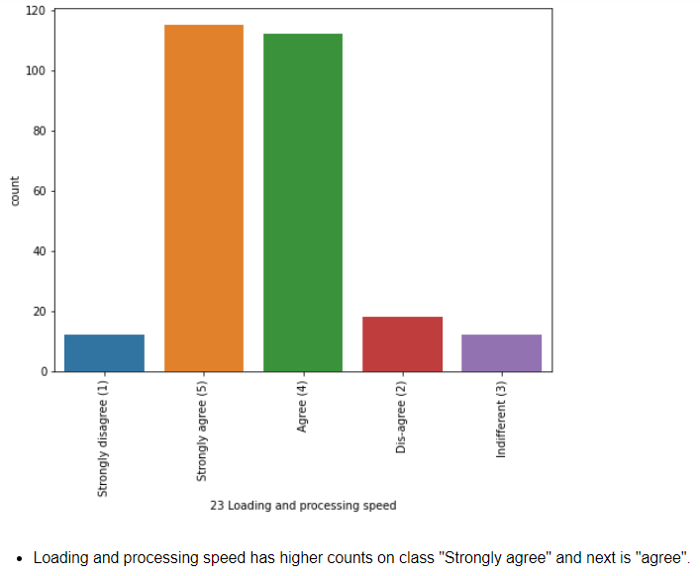

Slide 25
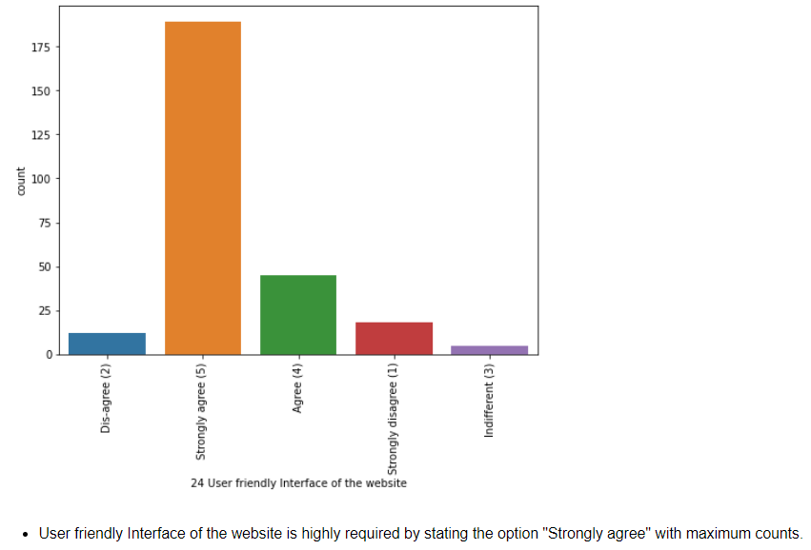

Slide 26
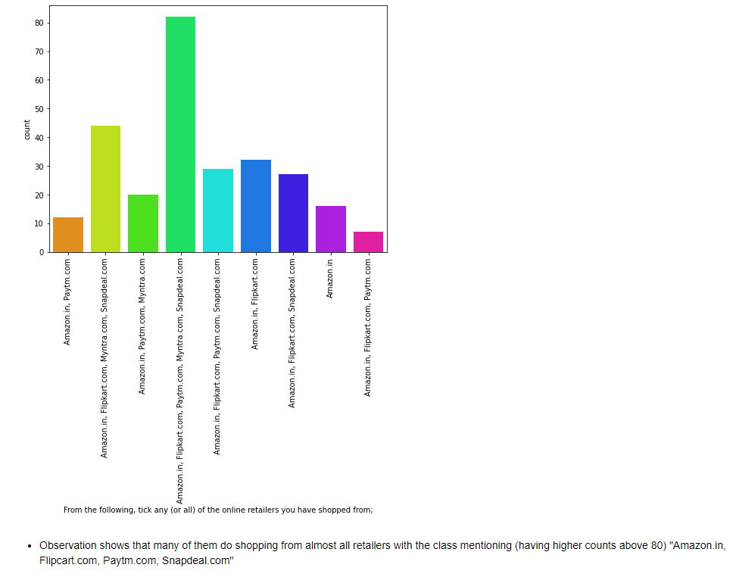

Slide 27
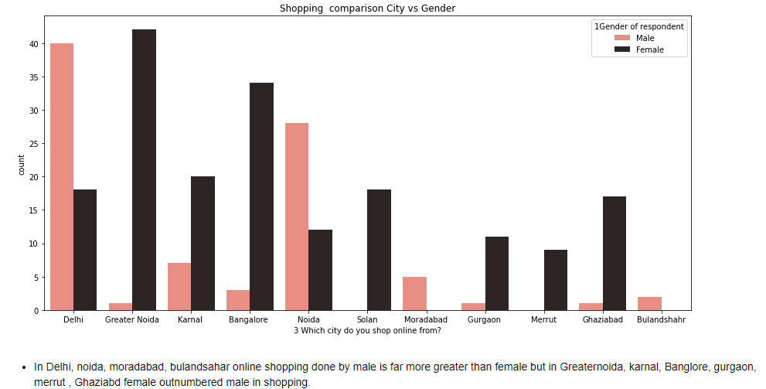

Slide 28
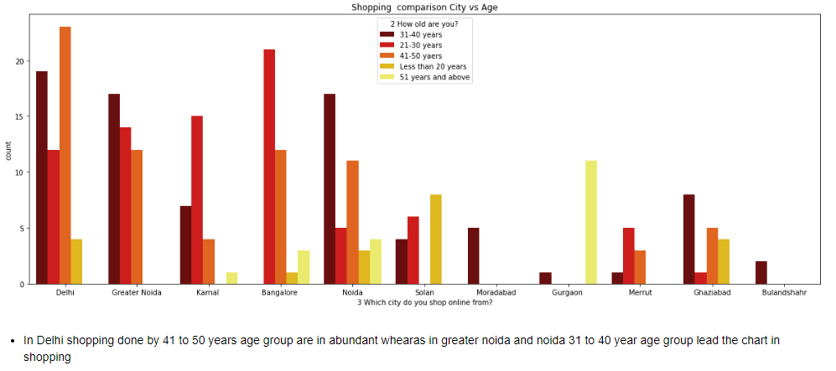

Slide 29
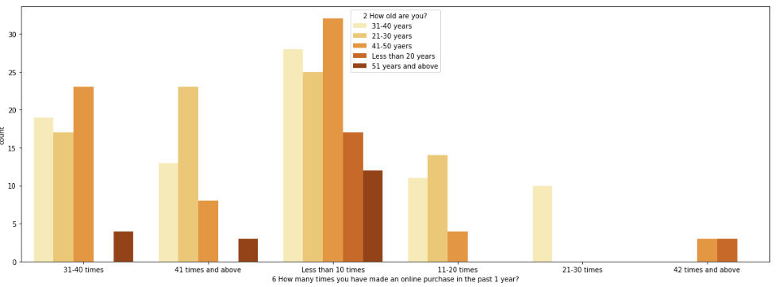

Slide 30


Slide 31
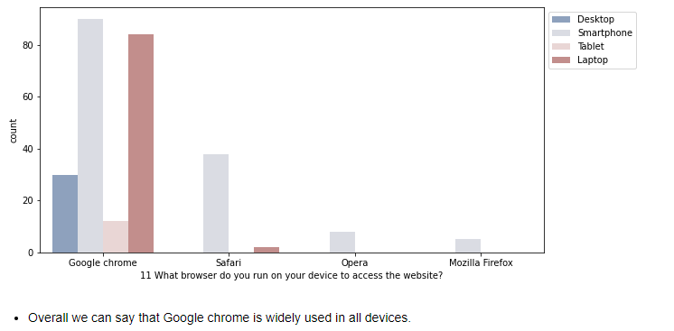

Slide 32
Conclusion
Majority of the people strongly agree that online store plays vital role in Purchases with many factors as explained above EDA.
Customer satisfaction has emerged as one of the most important factors that guarantee the success of online stores.
Major factors that contributed to the success of an e-commerce store have been identified as: service quality, system quality, information quality, trust and net benefit.
The research furthermore investigated the factors that influence the online customers repeat purchase intention.
The combination of both utilitarian value and hedonistic values are needed to affect the repeat purchase intention (loyalty) positively. The data is collected from the Indian online shoppers.
Results indicate the e-retail success factors, which are very much critical for customer satisfaction.
As per the given data set, almost most of the factors that help in customer retention shows the higher preference with Amazon.in, it has the highest recommendation to other friends.

Slide 33
Thank You
From: Preeti Singh

